Slide 1
Transforming the Automobile Insurance Claims through GenAI
By Team 13 & 14

Slide 2

Agenda
1
Combined Solution Slide 3 — 8
2
Team 13 Specific Deliverables Slide 9 — 12
3
Team 14 Specific Deliverables
Slide 13 — 14
4
Current Progress
Slide 15 — 17
5
Roadblocks Slide 18 — 19
6
Next Steps Slide 20 — 21

Slide 3

Combined Solution

Slide 4
Option 1: Rule-Based AI Options Analysis
Option 1 | Feasibility | Solution Name | Solution Cost
Data Team | Cost-effective: more cost-effective for small/medium workloads. Simplicity & Speed: Azure Functions are easier to set up and deploy → faster development time Scalability Limits: upper timeout durations of 10 minutes thus, issue when our dataset grows Cold Latency Starts: AF is serverless thus, will introduce latency due to cold starts → affect performance | Azure Data Lake (Gen 2) | A$0.44745/month
 |  | Azure Function | The first 400,000 GB/s and 1,000,000 executions are free. Each 1,000,000 executions more is A$0.31
AI Team | High Transparency: Rule-based AI systems operate on predefined rules that are easy to trace and audit. This transparency is crucial in industries where regulatory compliance and accountability are paramount. Ease of Implementation: The implementation of a rule-based AI system is relatively straightforward, as it relies on clear logic paths that are simple to set up and modify. Lower Computational Costs: Compared to machine learning models, rule-based systems require less computational power, resulting in lower operational costs. | Azure Functions (Consumption Plan) | Free for initial use (Pay-per-use)
 |  | Azure SQL Database (Basic Tier) | A$8.24
 |  | Microsoft Defender for Cloud (per billable resource) | $0.011/h x 24 hours x 30 days = $7.92 Four billable resources in total 7.92*4=$31.68
Total Options Cost p/month |  |  | A$40.37*
*Assumption of 1,000 actions, billable resource is all cloud services (5, not Defender itself)
**Month has 30 days
Notes:
Alt to PowerBI
Tableau
looker microsoft
quilk microsoft

Slide 5
Option 2: AI Options Analysis
Option 2 | Feasibility | Solution Name | Solution Cost
Data Team | Cost-effective: more cost-effective for small/medium workloads. Simplicity & Speed: Azure Functions are easier to set up and deploy → faster development time Scalability Limits: upper timeout durations of 10 minutes thus, issue when our dataset grows Cold Latency Starts: AF is serverless thus, will introduce latency due to cold starts → affect performance | Azure Data Lake (Gen 2) | A$0.44745/month
 |  | Azure Function | The first 400,000 GB/s and 1,000,000 executions are free. Each 1,000,000 executions more is A$0.31
AI Team | Advanced Capabilities: Combines the strengths of machine learning and anomaly detection with cutting-edge AI technologies like GPT-4, offering a comprehensive fraud detection solution. Scalability: The AI-driven solution is highly scalable, making it suitable for large organizations with operations across multiple geographies. Flexibility: GPT-4 offers unparalleled flexibility in fraud detection, with the ability to adapt to new data sources, integrate with various systems, and evolve with emerging fraud patterns. | Azure OpenAI Service (GPT-4o-mini) | GPT-4o-mini: $0.00023 per 1,000 input*; $0.0010 per 1,000 output*
 |  | Azure Machine Learning (E8a v4) | A$0.925/hour**
 |  | Microsoft Defender for Cloud (per billable resource) | $0.011/h x 24 hours x 30 days = $7.92 Four billable resources in total 7.92*4=$31.68
Total Options Cost |  |  | A$78.38*
*Assumption of 1,000 input & output **Assuming 50 hours on Azure ML
***Month has 30 days

Slide 6
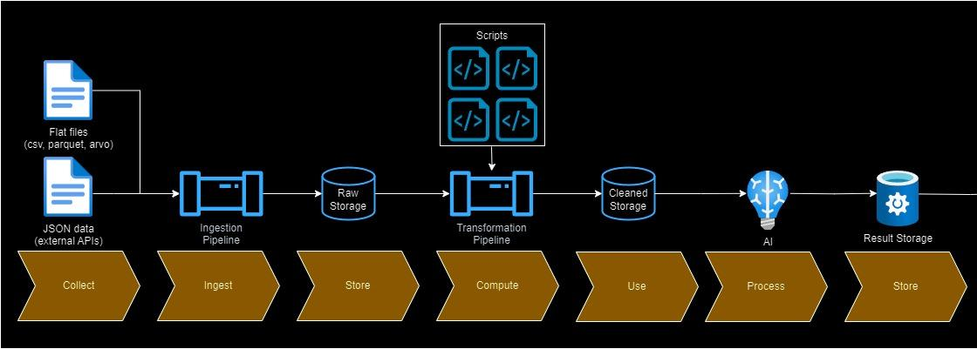
HLSD Rule-Based AI

Slide 7
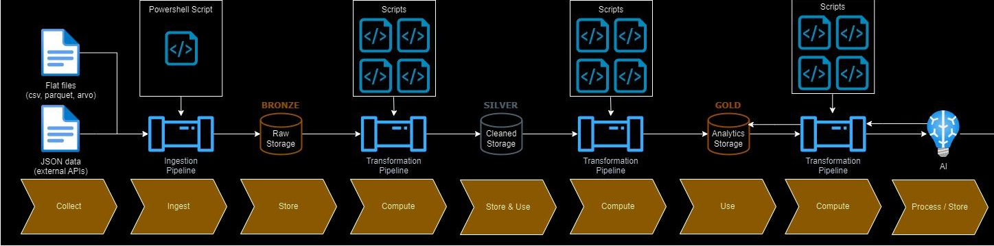
HLSD AI

Slide 8

Team 13 Completed Deliverables

Slide 9


Key Stakeholders of AICs
Claims Officer
Underwriter
Actuary
• To understand and interpret policy language and legal terms especially those dealing with exclusion clauses.
• Assessing the accuracy of claimant statements and supporting documentation.
• Reconciliation of information from various reports.
• Ensuring regulatory compliance requirements.
• Analysing policy terms and conditions for pricing and premiums.
• Being up-to-date with actuarial science and regulations to ensure accurate assumptions.

Slide 10
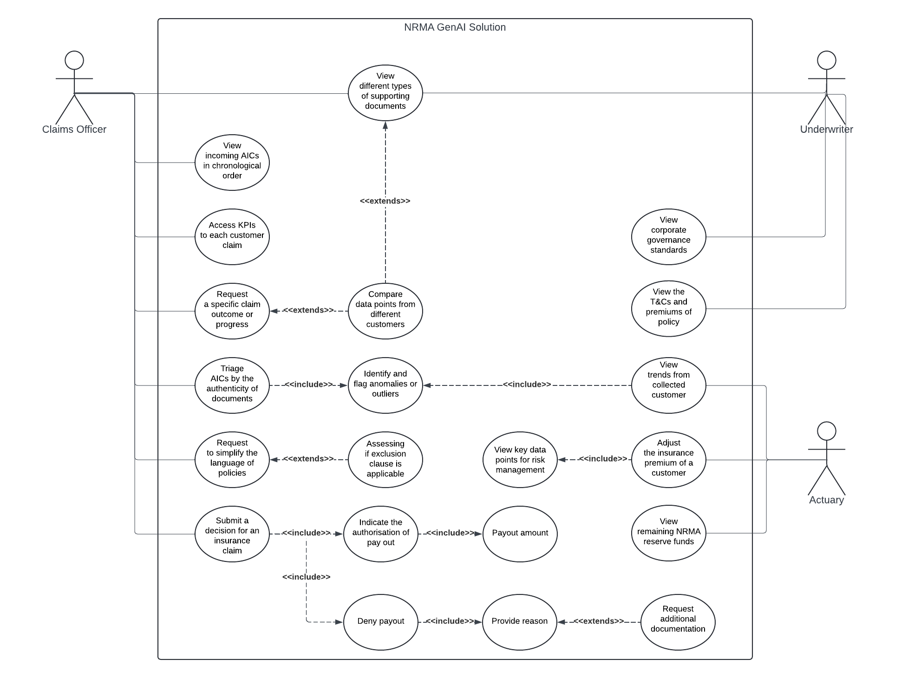
Use Case Revised

Slide 11

Option 2 LLM Demonstration
Requesting Information
Analysis & Insights
Please summarise the information of ClaimID 10
In ClaimID 10, Can you compare the customer at fault column with the police report reference?
Claims Officer
Claims Officer
Here is the summary of ClaimID 10:
ClaimID: 10
AccidentType: Rear Collision
WeatherCondition: Windy
IncidentTime: 9:28:27 PM
NumVehiclesInvolved: 1
PoliceReportReference: 22
DriverID: 43
AtFault: TRUE
DamageAmount: 32900
Injuries: 2
The difference between customer at fault column and police report reference are:
At Fault: TRUE
Police Report Reference: 22 [False, no police report exists under #22]
LLM
LLM
What is the recommended outcome?
Claims Officer
From the available data, it is recommended that ClaimID 10 is rejected due to the lack of supporting data from the customer and the non-existence of Police Report #22. This may be an attempt of fraudulently claiming an insurance payout by DriverID #43.
LLM
*The claims officer must verify the accuracy of the LLM's outcome by cross-referencing the extracted data with the original information.

Slide 12

Team 14 Completed Deliverables

Slide 13
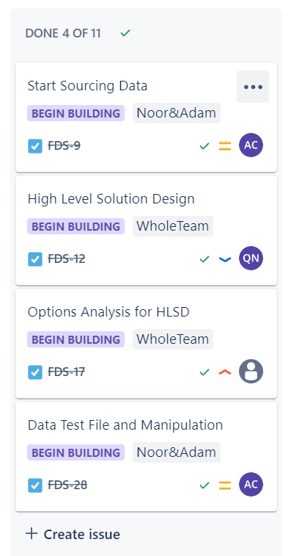

Completed Tasks
Built High Level Solution Design
Refined Options Analysis and settled on solution approach
Found data sources and identified relevant features
Defined database schema
Experimented with python scripts to establish proof of concept

Slide 14

Current Progress

Slide 15

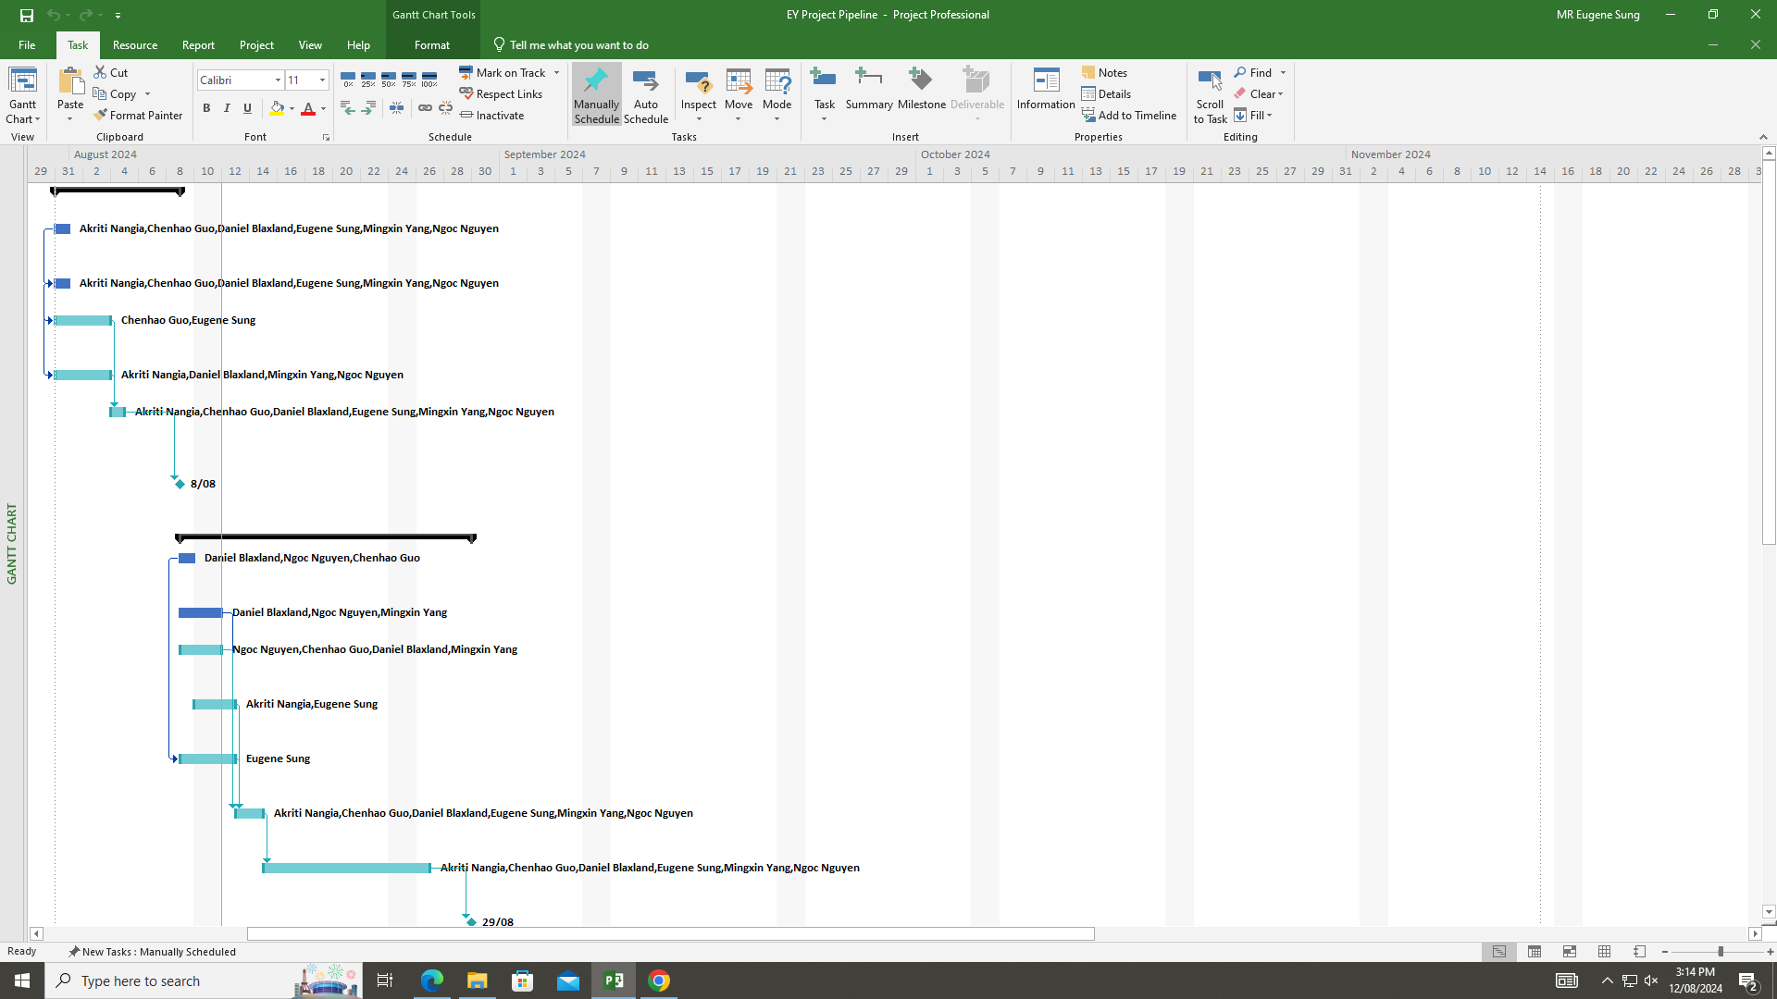
Team 13 Current Progress
On Track To Complete
Selecting the final solution with mentors.
Completing final draft of D2 by Sunday 25th of August 11:59pm
Transitioning towards Parent Task 3 (System Development Process)
Completing new deliverables for Sprint 4
Considered alternatives to PowerBI for data visualisation

Slide 16
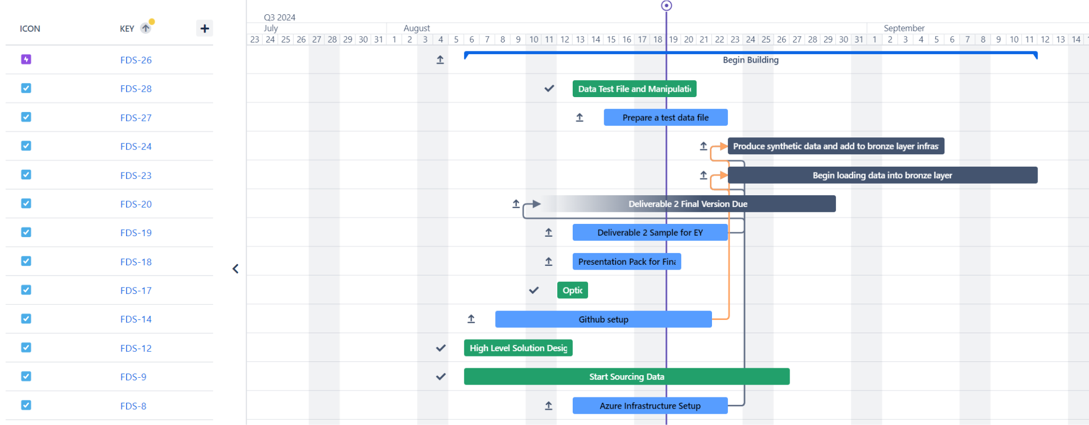
Team 14 Current Progress

Slide 17
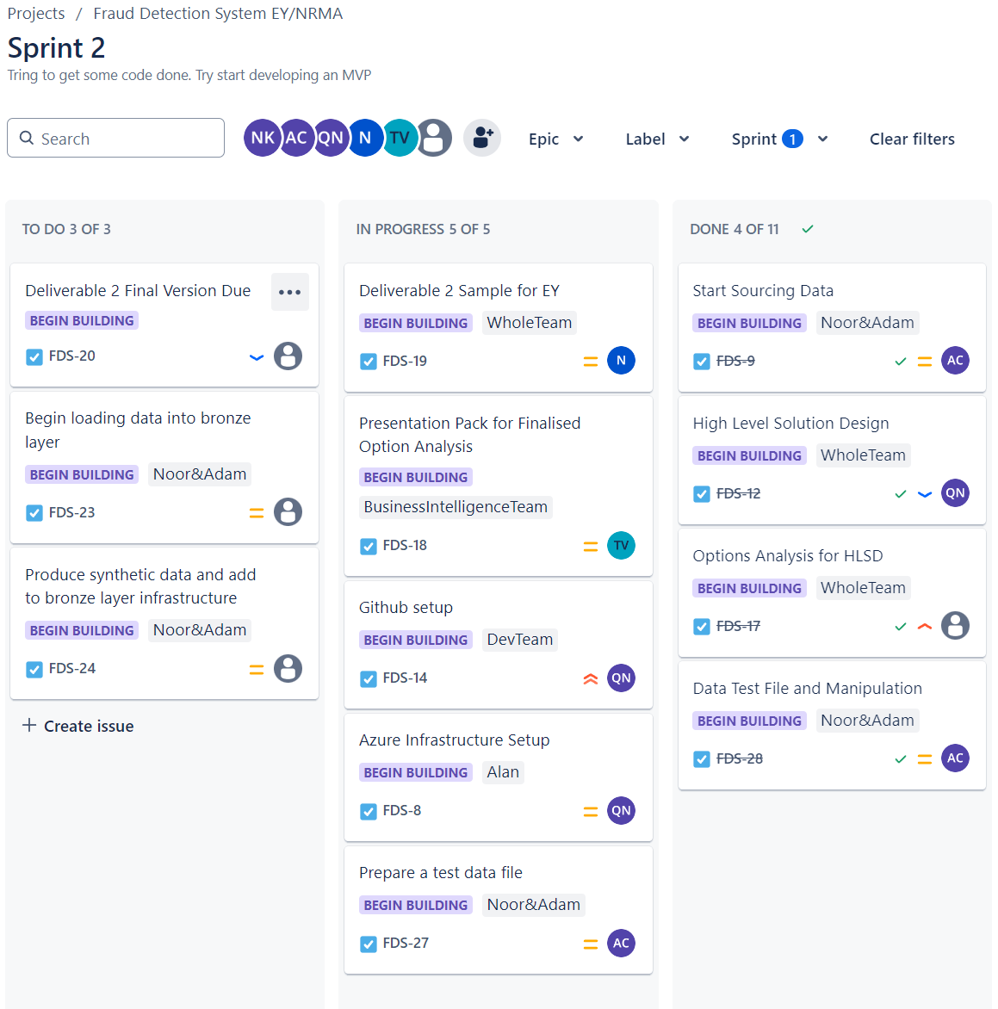
Team 14 Current Progress Cont.
Main Planned & Ongoing Tasks:
Deliverable 2 Assignment for University
Github Setup
Azure Infrastructure Setup
Producing synthetic data
Sourcing data consistent with predefined schema

Slide 18

Roadblocks

Slide 19
Roadblocks
Roadblocks
Sourcing data that is consistent with our dataset schema.
Designing the GitHub repository turned out to be more complex than we originally anticipated.
Determining optimal methods for synthesising data.
Optimising our Azure infrastructure.
Integration between data and AI team
Selecting only the necessary AI models
Notes:
Github repository - Hoping to ask Noah about this
Synthesising data - so many options that we are trying to decide from (we have three methods right now)
We are still trying to figure out the metrics
Skit learn
GAN - basically a neural network which can learn and replicate data
Using OpenAI’s Codex to try replicate trends in source data
Our core services will be Azure Functions , Data Lake Storage
however, there are more services that might be more beneficial. We are still brainstormin

Slide 20

Next Steps

Slide 21
Next Steps
Collaboration Between Teams
Completing D2
Completing the Azure Structure setup for Data
Trialling the Azure solutions

Slide 22
Thank You

